Slide 1
Content-Based Restaurant Recommendation System
Using Zomato Bangalore Dataset

Slide 2
Contributors
Rinshad Choorappara
Aswin Michat Ramesh
Sreya Asok
Riya Johnson

Slide 3
Introduction
This presentation introduces a content-based restaurant recommendation system developed using the Zomato dataset.
The system aims to assist users in discovering restaurants based on their preferences and past reviews.
Leveraging machine learning techniques, the system provides personalized recommendations to enhance user dining experiences.

Slide 4
Project Scope
Bengaluru's food industry is dynamic and competitive, with a diverse range of cuisines and dining experiences. New entrants face challenges such as high real estate costs, rising food prices, and intense competition from established players.
Consumers demand convenience, quality, and variety in their dining experiences. Understanding customer preferences, dietary trends, and cultural influences is crucial for success in the food business.
Utilizing data analytics and machine learning techniques to derive actionable insights enables businesses to make informed decisions, enhance operational efficiency, and drive growth.

Slide 5
Project Scope
By analyzing customer reviews, location demographics, and competitor strategies, businesses can strategically position themselves to meet evolving market demands and capitalize on emerging opportunities.

Slide 6
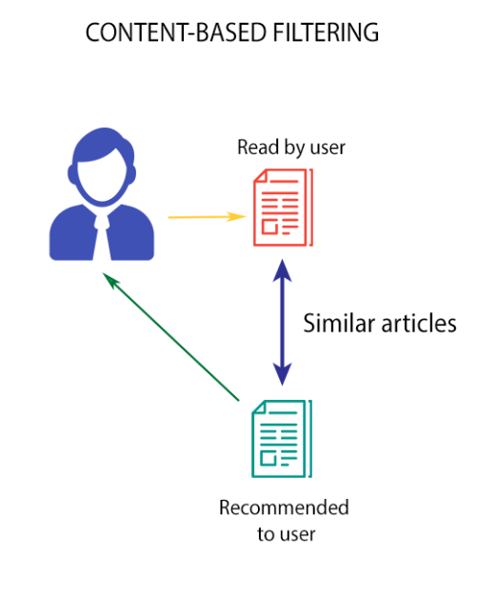
Content Based Filtering
In the context of restaurant recommendation systems, content-based filtering analyzes the characteristics of restaurants and recommends similar ones based on user preferences.
This approach relies on the features or "content" of items, such as restaurant attributes and user reviews, to generate personalized recommendations.
Content-based filtering systems do not require explicit feedback from users and can make recommendations based solely on the properties of items and user profiles.
Advantages of content-based filtering include its ability to provide personalized recommendations and its resilience to the "cold start" problem, where new items or users have limited data available for recommendation.

Slide 7
Zomato Dataset
Zomato is a popular online platform that provides information about restaurants, including user reviews, ratings, and menu details.
The dataset used in this project contains comprehensive information about restaurants in Bengaluru, including their names, locations, cuisines, ratings, and reviews.
Leveraging this rich dataset, our goal is to develop a robust recommendation system that assists users in discovering restaurants that align with their preferences and tastes.

Slide 8
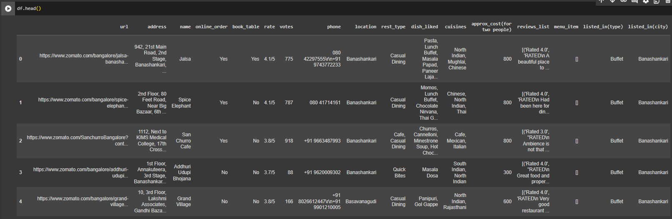
Zomato Dataset

Slide 9
Data Understanding
The dataset consists of 51,717 rows and 17 columns.
Columns:
'url', 'address', 'name', 'online_order', 'book_table', 'rate', 'votes', 'phone', 'location', 'rest_type', 'dish_liked', 'cuisines', 'approx_cost(for two people)', 'reviews_list', 'menu_item', 'listed_in(type)', 'listed_in(city)'
Data Types: Most columns contain object (string) data, except for the 'votes' column, which is of integer type.
Missing Values: Several columns have missing values, including 'rate', 'phone', 'location', 'rest_type', 'dish_liked', 'cuisines', and 'approx_cost(for two people)'. These missing values need to be handled during data preprocessing.

Slide 10
Data Understanding
Potential Insights:
The dataset contains rich information about various aspects of restaurants, such as their ratings, cuisines, locations, and customer reviews. This information can be leveraged to gain insights into the restaurant industry and build recommendation systems to assist users in finding suitable dining options.
Data preprocessing is an important part in this project since we have wide varieties of datas.

Slide 11
Data Preprocessing
Data Cleaning:
Loading the dataset.
Handling duplicates and missing values.
Removing unnecessary columns
Transforming columns like 'rate' and 'cost'.
Applying MinMax scaling to the 'Mean Rating' feature and rounding to 2 decimal places

Slide 12
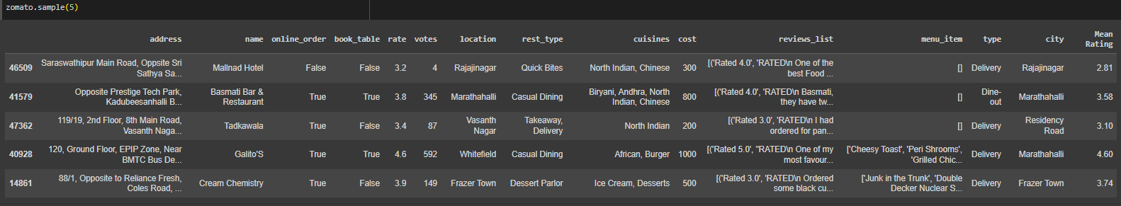
Data Preprocessing

Slide 13
Text Preprocessing
Text Cleaning (Reviews List)
Lowercasing: Convert text to lowercase.
Removing Punctuation: Eliminate punctuation marks from text data.
Removing Stopwords: Omit common stopwords from text. (Reviews)
Removing URLs: Delete URLs from text.
Correcting Spelling Errors in the restaurant name

Slide 14
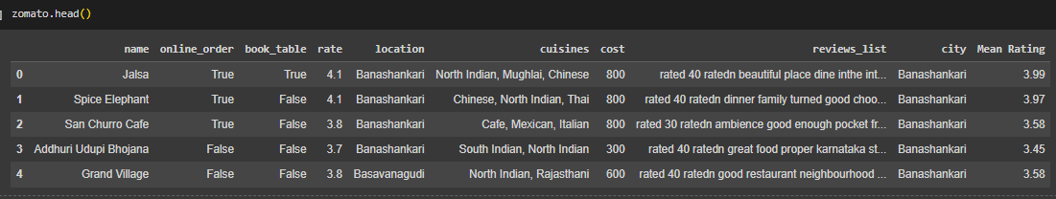
Text Preprocessing

Slide 15
Term Frequency-Inverse Document Frequency (TF-IDF)
First we randomly sample 50% of data
TF-IDF is a numerical statistic that reflects the importance of a word in a document relative to a collection of documents.
It plays a crucial role in natural language processing tasks by quantifying the relevance of words in textual data.
TF-IDF is used to convert textual data into numerical vectors, where each dimension represents a unique word and its importance in the document.
In the context of the project, TF-IDF is instrumental in calculating the similarity between restaurants based on their reviews, enabling the recommendation system to identify similar restaurants.

Slide 16
Recommendation Function:
The recommendation function takes a restaurant name as input and generates personalized recommendations for similar restaurants.
Utilizing cosine similarity scores calculated with TF-IDF, the function identifies restaurants with similar reviews.
Steps involved in the recommendation process include filtering out the input restaurant from the recommendation list and sorting recommendations by rating.
An example of using the recommendation function with a sample restaurant name will be provided to illustrate its functionality.

Slide 17
Recommendation Function:
The result is then filtered to check whether there is any restaurant of the same cuisine is available in the same city. If so, the list will be still sorted or else, it’ll display the general list.

Slide 18
Implementation
The recommendation system is implemented using Python and relevant libraries such as pandas and scikit-learn.

Slide 19
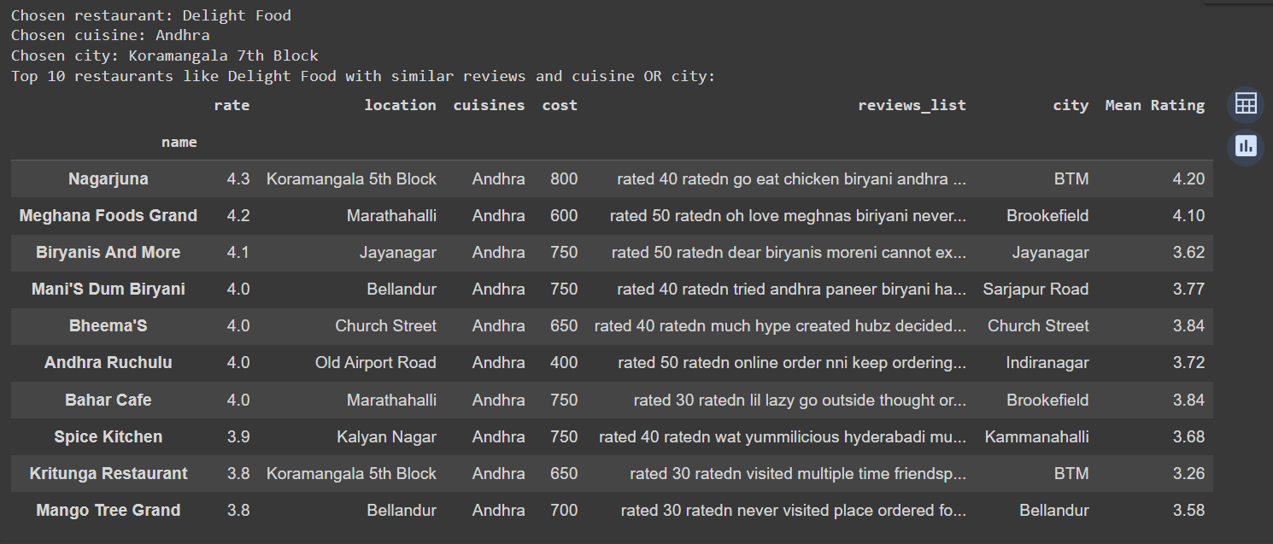
Results (After)

Slide 20
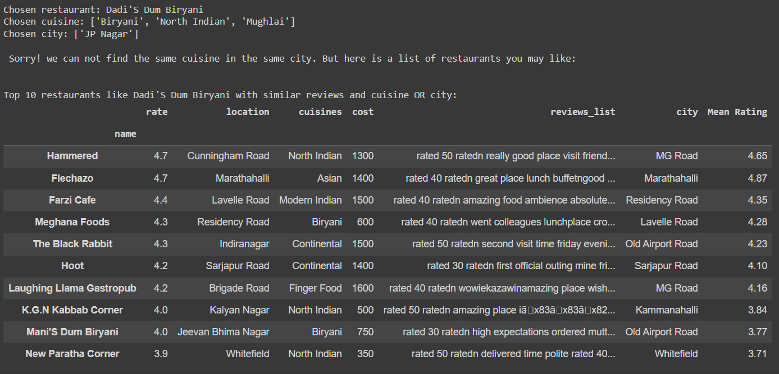
Results (After)

Slide 21
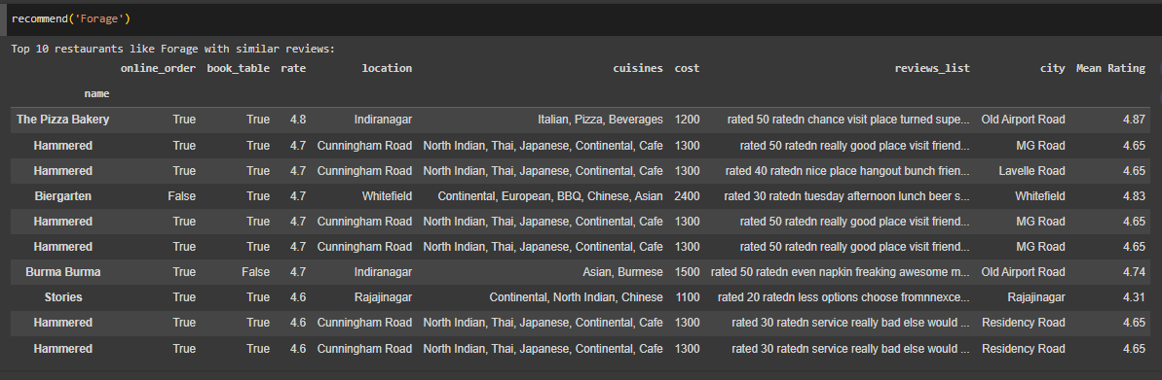
Results (Before)
Time average taken to give the result: 58.65 ms

Slide 22
Conclusion
Restaurant recommendation systems play a crucial role in enhancing user experience and aiding decision-making in the dining domain.
Through the analysis of the Zomato dataset and the implementation of a content-based recommendation system, we have demonstrated the feasibility and effectiveness of personalized restaurant recommendations.
The system leverages advanced techniques such as TF-IDF and cosine similarity to provide users with tailored recommendations based on their preferences and past interactions.
By empowering users to discover similar restaurants with ease, the recommendation system contributes to an enriched dining experience and fosters exploration of diverse culinary offerings.

Slide 23
Challenges and Future Work
Evaluation
Expanding the dataset for a border recommendation system
Implementation of an app for Hotel Recommendations with the best UI
Implementing User Feedback Mechanisms and refining recommendation algorithms.

Slide 24
References
Zomato Restaurants Dataset
Scikit Learn : https://scikit-learn.org/
TF IDF : https://www.learndatasci.com/glossary/tf-idf-term-frequency-inverse-document-frequency/
Hotel Recommendation Notebooks | Github

Slide 25
Questions?

Slide 26
Thank You!

